Slide 1
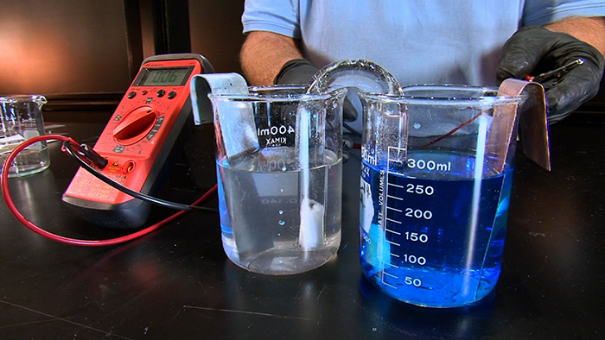
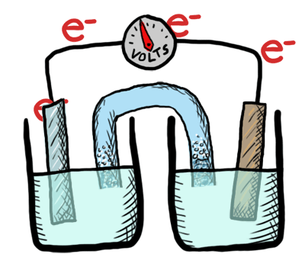
Galvanic cells and SRP table
Redox chemistry
ATAR Chemistry Unit 3 2022

Slide 2

Overview
Galvanic cells (also called voltaic cells)
Using SRP table to predict cell voltages

Slide 3
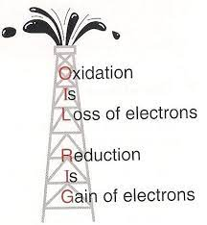
Review
Oxidation
a species is oxidized when it loses one or more electrons
It is seen as an increase in oxidation number
The Species oxidised is called a reducing agent or reductant
Reduction
a species is reduced when it gains one or more electrons
It is seen as a decrease in oxidation number
The Species reduced is called an oxidizing agent or oxidant

Slide 4
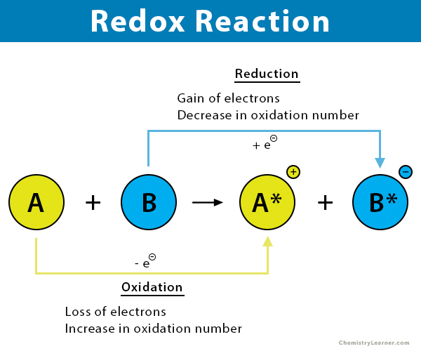
Review

Slide 5
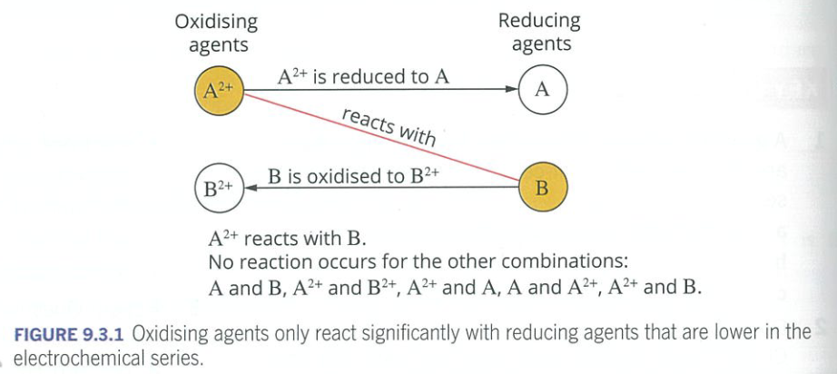
Review: Zinc and Copper

Slide 6
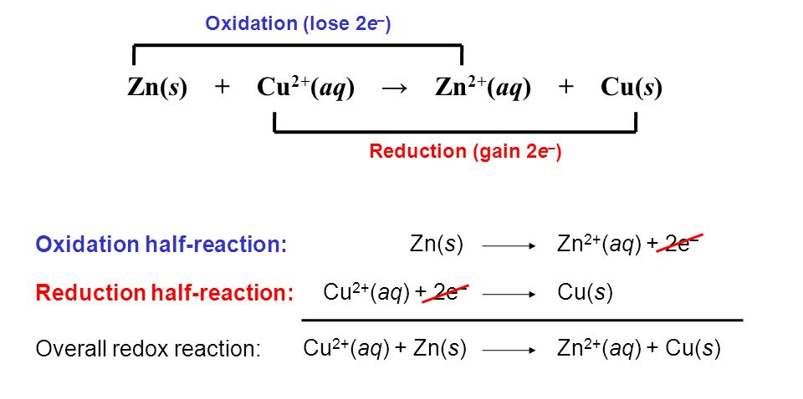
Review: Zinc and Copper

Slide 7
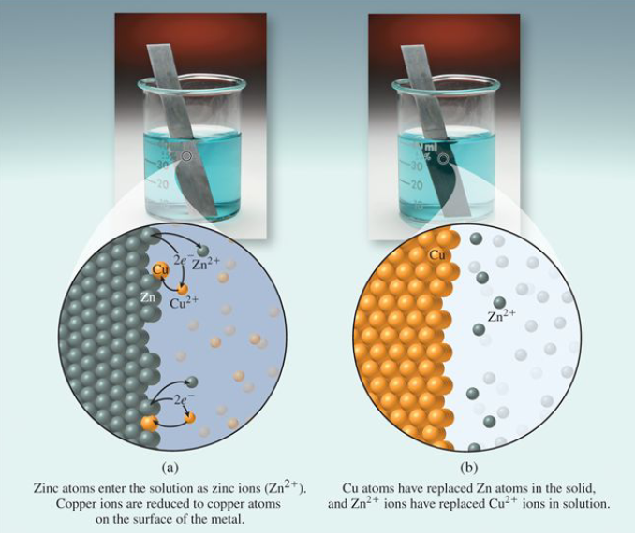

Slide 8
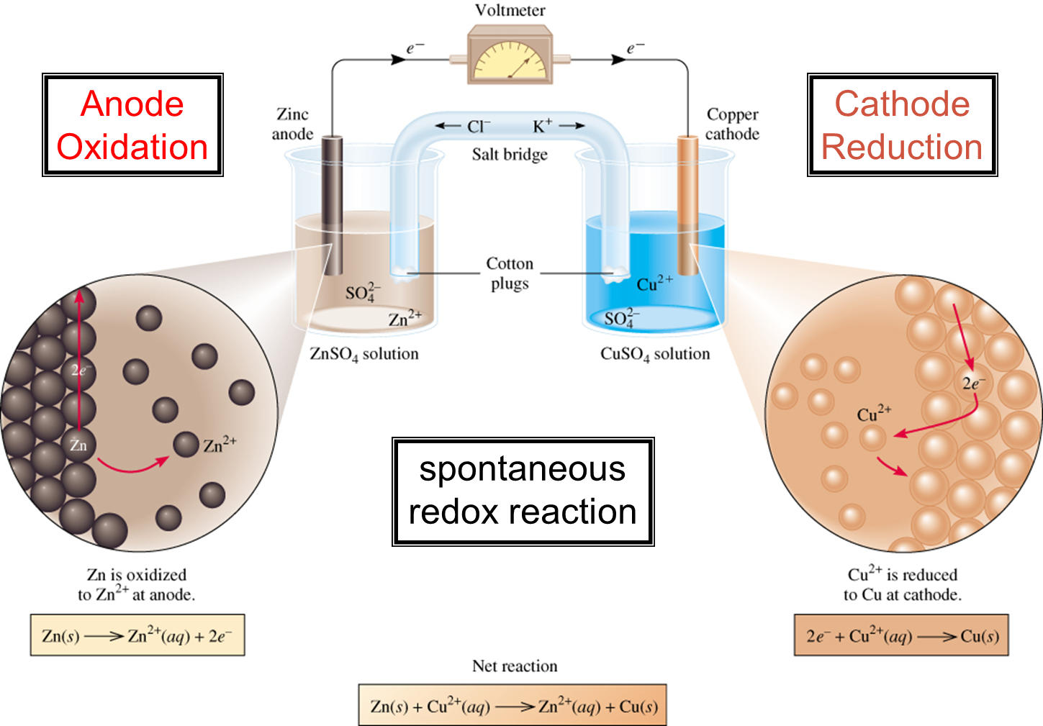
The Daniell cell

Slide 9
Galvanic cells
As the oxidising reagent is physically separated from the reducing agent, the transfer of electrons can take place via an external conducting medium (wire).
The moving electrons forms a current that can be used to do work (eg light, motor).
A salt bridge is required to complete the electrical circuit and maintain the neutrality of each half cell.
The current in the salt bridge is due to the moving anions and cations.
Galvanic cells convert chemical potential energy into electrical energy

Slide 10
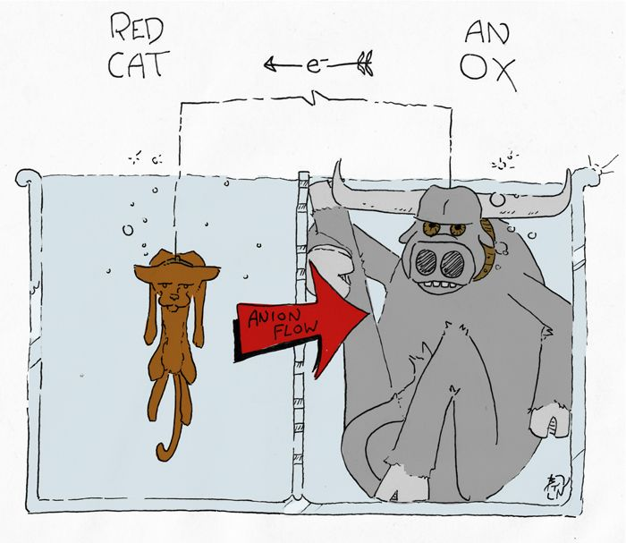
Galvanic cells
Oxidation at the anode
Reduction at the cathode

Slide 11
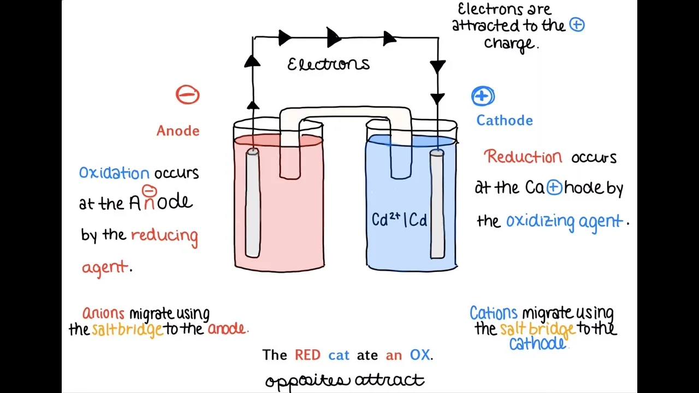
Galvanic cells

Slide 12
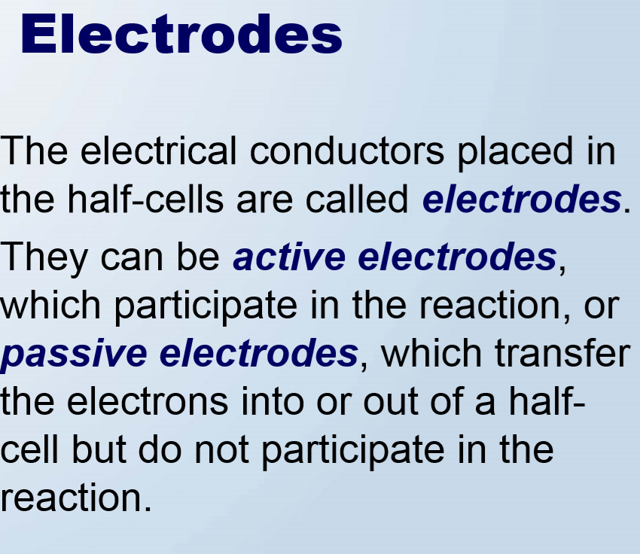
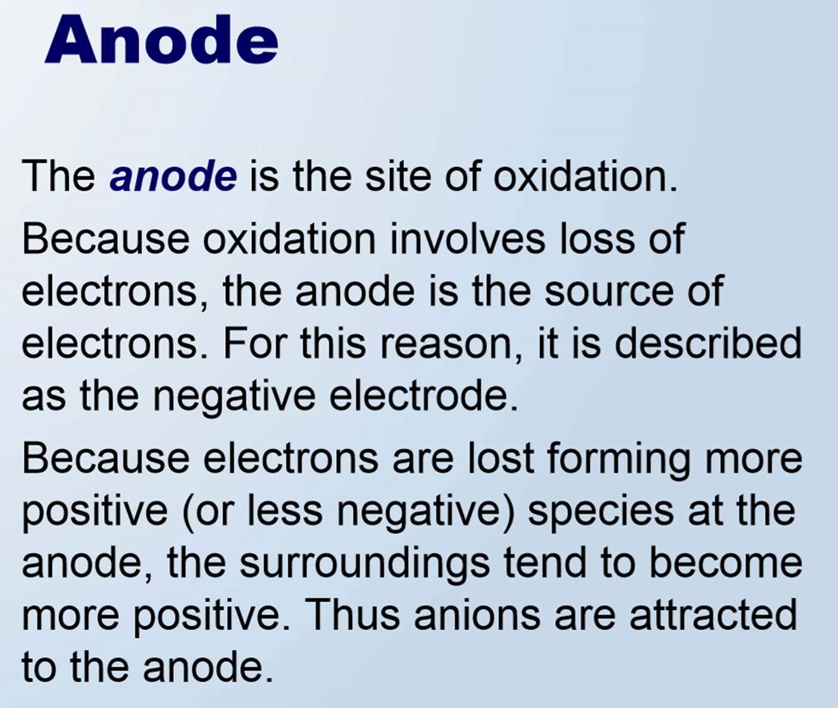
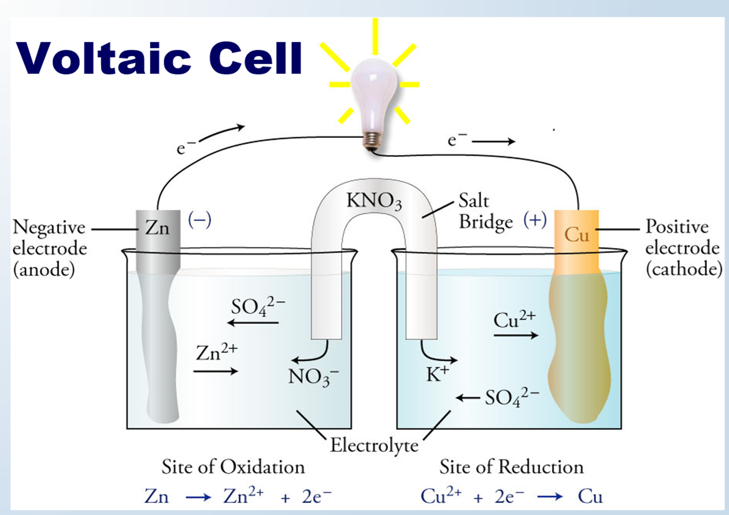
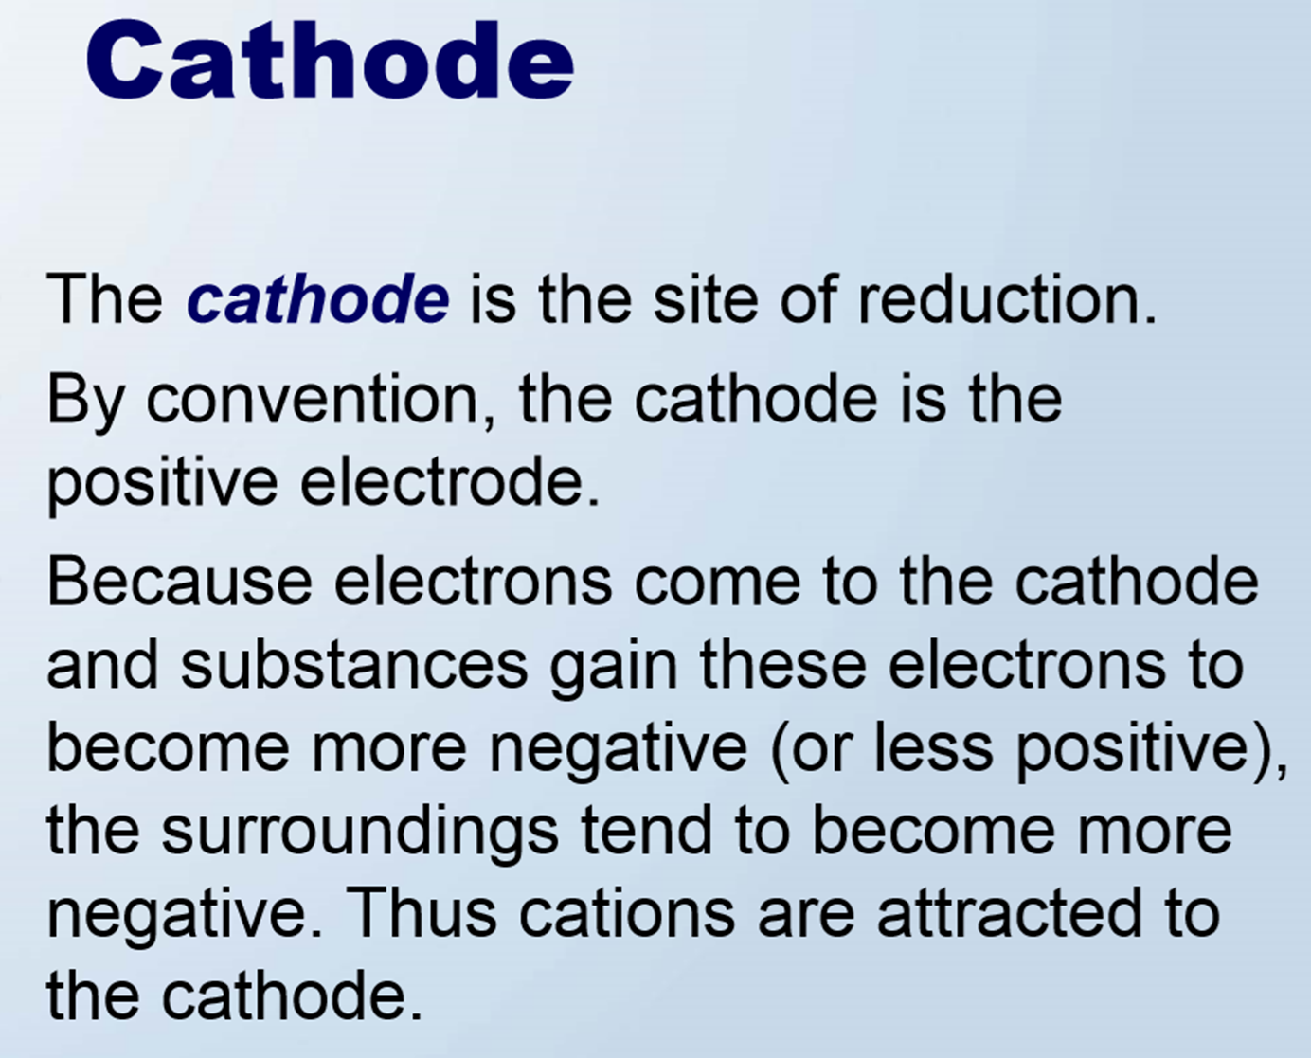
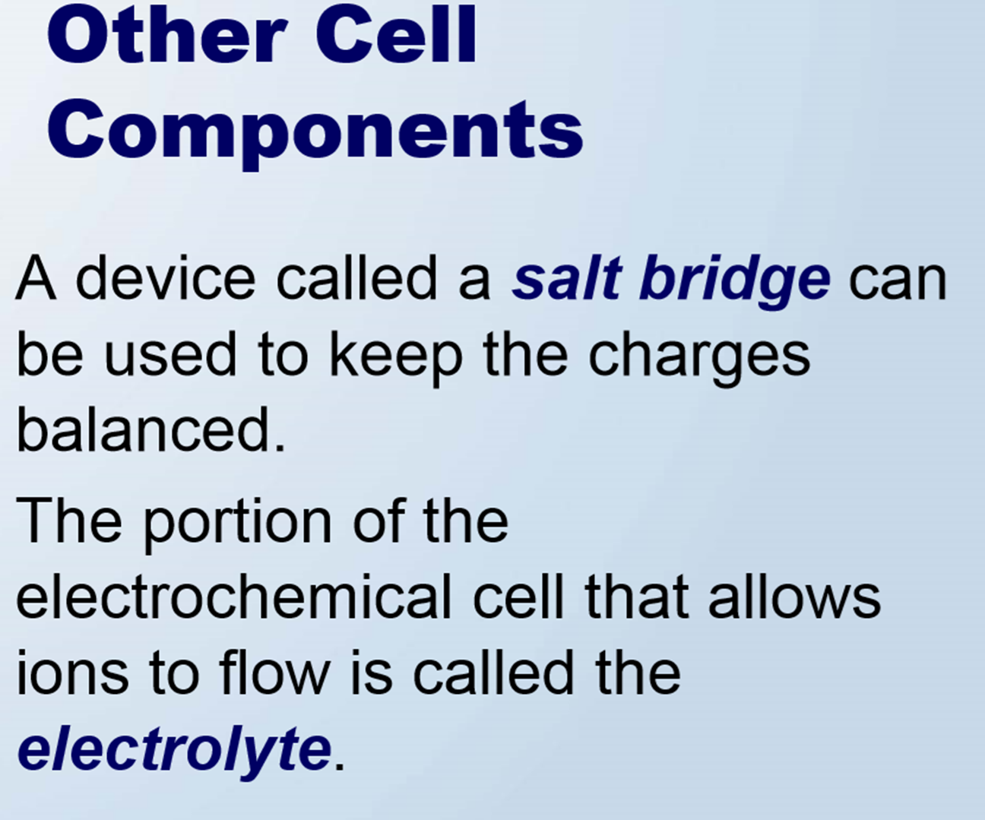

Slide 13
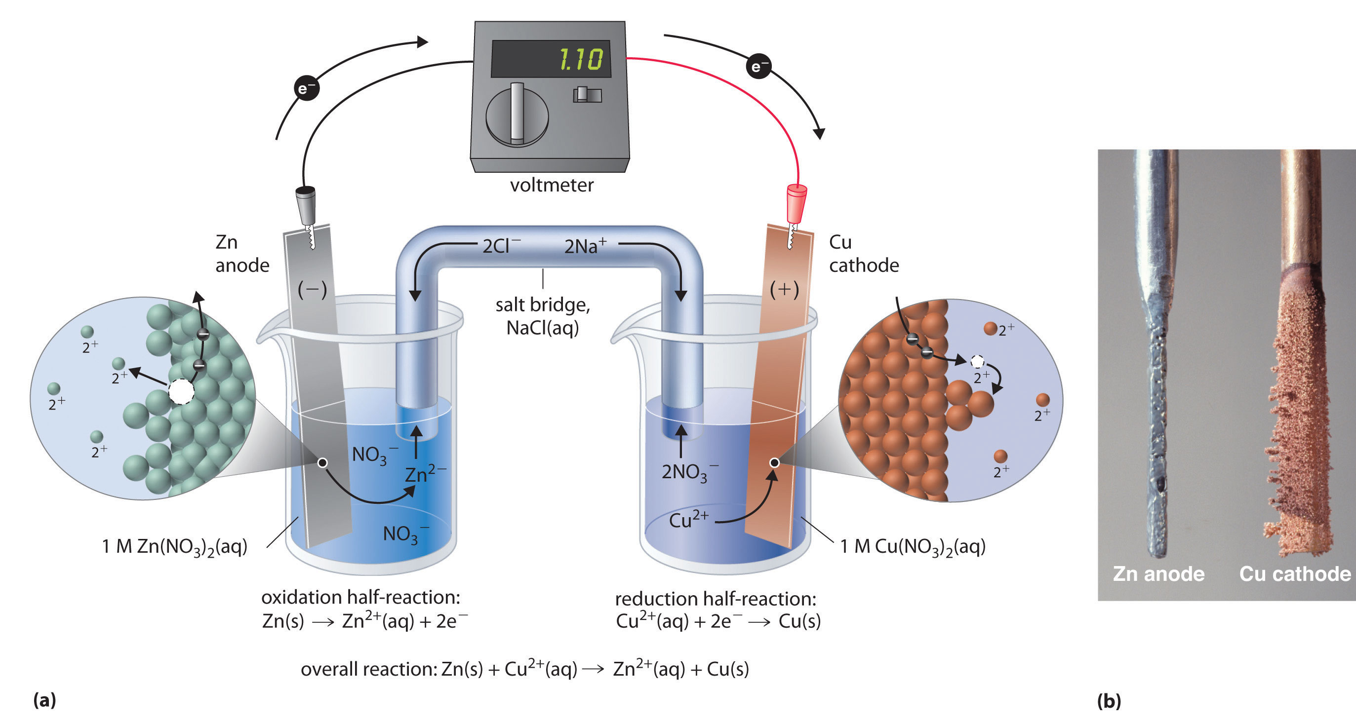

Slide 14
Cell notation
A galvanic/electrochemical cell may be represented by the following
ANODE CATHODE
Zn(s) Zn²⁺ (1M) Cu² (1M) Cu(s)
The single lines represent phase boundaries (e.g. solid anode to 1M liquid) and the double lines represent the salt bridge.

Slide 15
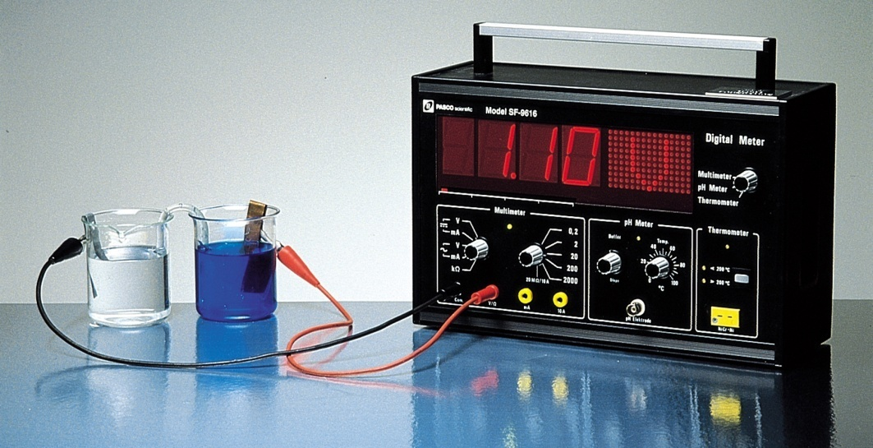
Galvanic cells
The difference in electrical potential between the anode and cathode is called the Electromotive force (EMF) or the cell potential (ε_{cell}). It is measured on a voltmeter (in Volts).
For the Daniell cell the voltage at standard conditions is 1.10 V
Zn (s) + Cu²⁺ (aq) Cu (s) + Zn²⁺ (aq)

Slide 16
Galvanic cells
It was very confusing for early scientists to know why the current flowed, which is why it was thought some “force” pushed the current and hence EMF. The name has remained.
The EMF is an intensive property and is independent of the volume of solution and the size of the electrode.
Some reference point is needed to investigate electrochemical cells and so the “sea level” for measurements is the Standard Hydrogen Electrode (SHE)
The SHE is used to measure the potential of other electrodes/half cells.

Slide 17
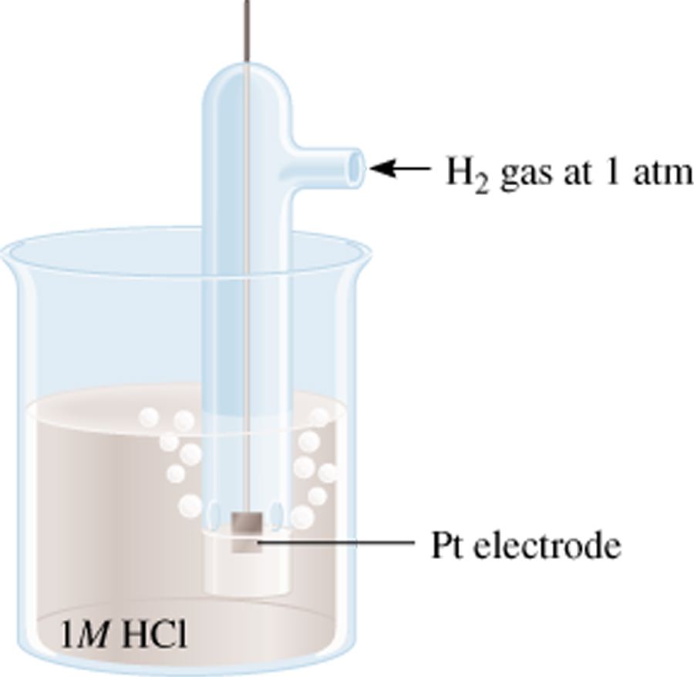
Standard hydrogen electrode (SHE)
The hydrogen electrode has H₂ gas bubbling in (at 1 atm) into HCl solution (1M) at 25°C. There is an inert Pt electrode to allow the electrons to be conducted.
The hydrogen reduction is assigned a E°_{red} of 0.00 V
The cell can act as an anode or cathode depending on what other half cell it is attached to.
2e⁻ + 2H⁺ (1 M) 2H₂ (1 atm)
E⁰ = 0.00 V (by definition)
Reduction Reaction
NB: Any time you see º, think “standard state conditions”

Slide 18
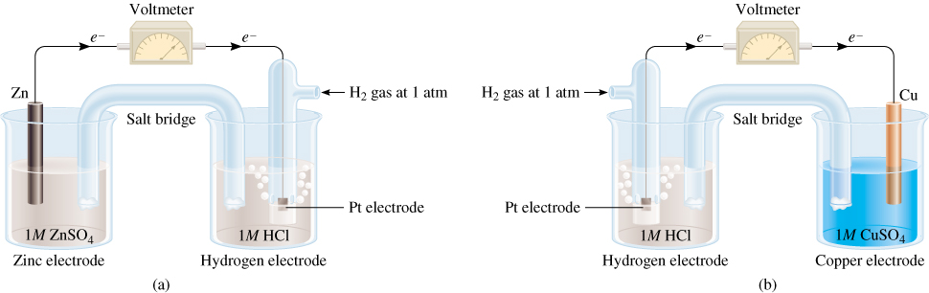
SHE with zinc half cell
The electrons flow into the SHE
The zinc electrode is seen to be consumed so is the Anode.
This makes the SHE the Cathode
Zn (s) | Zn²⁺ (1 M) || H⁺ (1 M) | H₂ (1 atm) | Pt (s)
Anode (oxidation):
Zn (s) Zn²⁺ (1 M) + 2e⁻
Cathode (reduction):
2e⁻ + 2H⁺ (1 M) 2H₂ (1 atm)

Slide 19
SHE with Zinc half cell
Standard emf (E⁰ )
cell
E⁰ = 0.76 V
cell
0
E⁰ = E_{red}+ E_{ox}
0
cell
E⁰ = E_{red} + E_{ox}
0
0
cell
0
0.76 V = 0 + E_{ox}
Zn (s) | Zn²⁺ (1 M) || H⁺ (1 M) | H₂ (1 atm) | Pt (s)
E_{Zn /Zn} = 0.76 V
2+
Note: in this combination the zinc electrode is E°ox and requires polarity change to convert to E°red
Zn²⁺ (1 M) + 2e⁻ Zn E⁰ = -0.76 V

Slide 20
SHE with Copper half cell
E⁰ = 0.34 V
cell
0
E⁰ = E_{red} + E_{ox}
0
cell
0.34 = E_{Cu /Cu} + 0
0
2+
0
E_{Cu /Cu} = 0.34 V
2+
Note: here the copper half cell is already a reduction
Pt (s) | H₂ (1 atm) | H⁺ (1 M) || Cu²⁺ (1 M) | Cu (s)
Anode (oxidation):
H₂ (1 atm) 2H⁺ (1 M) + 2e⁻
Cathode (reduction):
2e⁻ + Cu²⁺ (1 M) Cu (s)

Slide 21
Galvanic cells
2e⁻ + Cu²⁺ (1 M) Cu (s)
0
E_{Cu /Cu} = 0.34 V
2+
Zn²⁺ (1 M) + 2e⁻ Zn E⁰ = -0.76 V
Having set the standard, SHE, as 0.00 volts we can use it to determine the E⁰ for other species
We can than rank them according to their Reduction Potential – their tendency to be reduced (gain electrons)
The more positive the value the higher the species tendency to be reduced
In above example Copper is more positive so it will be reduced, and Zinc will be oxidised

Slide 22
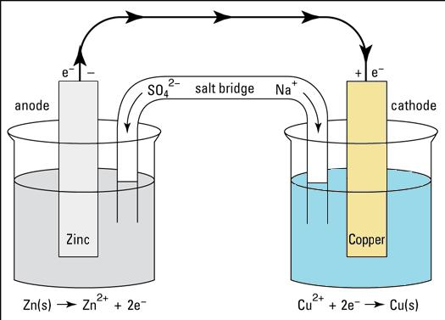
Galvanic cells
Positive E°_{cell} = spontaneous
Negative E°_{cell} = will not occur in that direction
E°_{cell} = E°_{ox} + E°_{red} = 0.76 + 0.34 = 1.10 V

Slide 23
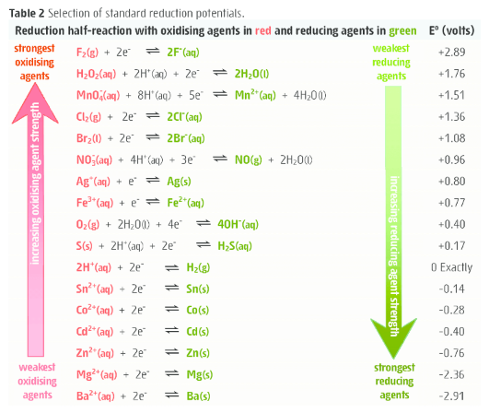
Standard reduction potential table
E⁰ is for the reaction as reductions
The more positive E⁰ the greater the tendency for the substance to be reduced
The more negative E⁰ the greater the tendency for the substance to be oxidized

Slide 24
Standard reduction potential table
Under standard-state conditions, any species on the left of a given half-reaction will react spontaneously with a species that appears on the right of any half-reaction located below it in the table
(the diagonal rule)
e.g. chlorine (Cl₂) will react with bromide (Br⁻)

Slide 25
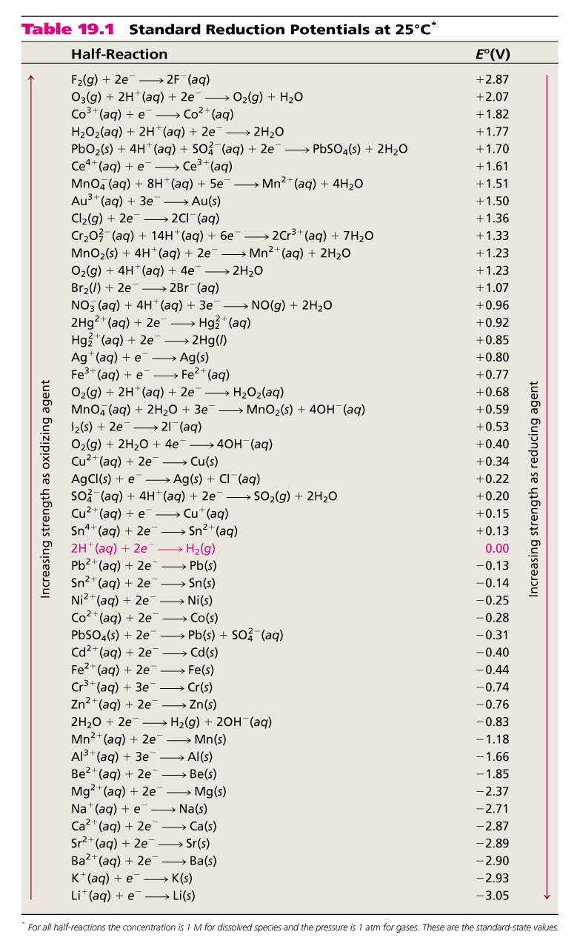
SRP table
The half-cell reactions are reversible
The sign of E⁰ changes when the reaction is reversed
Changing the stoichiometric coefficients of a half-cell reaction does not change the value of E⁰

Slide 26
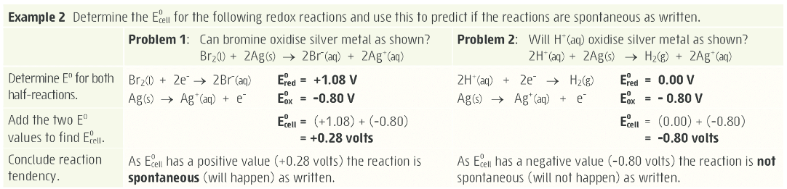
Standard Electrode Potentials: predicting reactions

Slide 27
Standard Electrode Potentials: predicting reactions
The relevant standard reduction potentials for a cell are:
Ni²⁺_{(aq)} + 2 e⁻ Ni_{(s)} E° = -0.26 V
Zn²⁺_{(aq)} + 2 e⁻ Zn_{(s)} E° = -0.76 V
From these values it can be predicted that:
Because Ni²⁺ is the stronger oxidant (has the larger reduction potential (E°)), the electrons in the wire flow towards the nickel half-cell
Ni²⁺ will gain electrons (undergo reduction)
Ni²⁺ will act as the oxidant
Zn will lose electrons (undergo oxidation)
Zn will react as the reductant
The Ni electrode will be the cathode and the Zn electrode the anode

Slide 28
Standard Electrode Potentials: calculating E⁰_{cell}
What is the standard emf of an electrochemical cell made of a Cd electrode in a 1.0 M Cd(NO₃)₂ solution and a Cr electrode in a 1.0 M Cr(NO₃)₃ solution?
Cd²⁺ (aq) + 2e⁻ Cd (s) E⁰ = -0.40 V
Cd is the stronger oxidizer
Cd will oxidize Cr
Cr³⁺ (aq) + 3e⁻ Cr (s) E⁰ = -0.74 V
Anode (oxidation):
Cr (s) Cr³⁺ (1 M) + 3e⁻
[x 2]
Cathode (reduction):
Cd²⁺ (1M) +2e⁻ Cd (s)
[x 3]
E⁰ = E_{red} + E_{ox}
0
0
cell
E⁰ = (-0.40) + 0.74
cell
E⁰ = 0.34 V
cell

Slide 29
Limitations
Standard reduction potential data is at standard conditions only, if you change the concentration or pressure of a species in a half-reaction the E value will change effecting its ranking compared to other reactions
You can actually build a Concentration cell! Cu/Cu²⁺ on each side but with hugely different concentrations (very extension)
Other major limitation – it only tells you if the reaction is spontaneous, it tells you nothing about the rate of a reaction

Slide 30
On going work
It is very important that you complete all of Set 10 by the end of this week

